Slide 1
Project: Test setup for IFM CR1301 industrial joystick
Project owner:
Rohan Vishawakarma : 3553424
Saurabh Borse : 3551516
No. of slides:15
Duration of presentation: 10 min.

Slide 2
Problem statement and deliverables
Problem statement:
To develop a test setup to demonstrate the features of the industrial joystick CR1301
Approach:
Conceptual development with system specification documentation, followed by software development and finally a prototype to implement the required features
Constraints:
Hardware constraints: ESP32 Microcontroller and MCP2515 CAN controller
Time constraints: Product must be delivered within 3 weeks
Communication protocol: CR1301 uses SAEJ1939 CAN communication protocol

Slide 3
System specification: Functional requirements and Use cases
Sr. No. | Mode/ function | Functionality
1 | Default mode: Manual | Clockwise encoder rotation lit up segment LEDs sequentially Anti-clockwise encoder rotation switch off segment LEDs sequentially Ability to switch to auto or color change mode
2 | Color change mode | Activation by pressing rotary button User can select any color for an individual led segment Color selection from 12 given color combination Ability to switch to any auto or manual mode
3 | Automatic mode | Activation by pressing status key no.6 All available LEDs must lit up Delay time for sequential color change based on encoder direction Ability to switch to any color change or manual mode
4 | Reset function | Activation by pressing status key no.1 All available LED color reset to yellow Encoder values reset to zero Switch to default mode

Slide 4
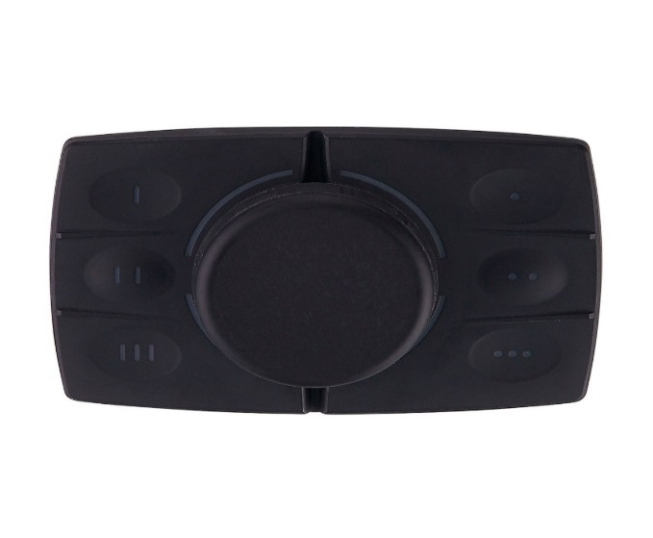
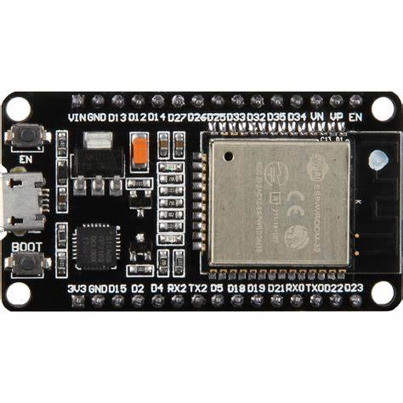
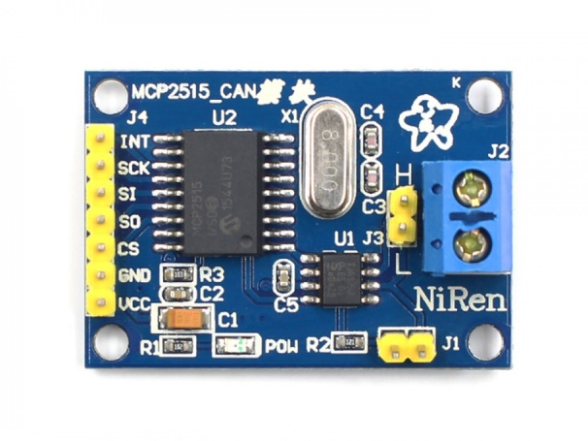
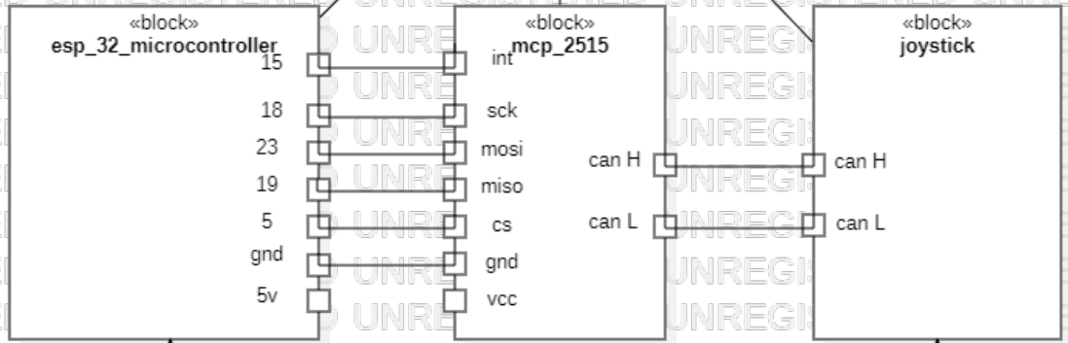
System Architecture
SPI Interface
CAN Communication
ESP32
MCP2515
Industrial joystick: CR1301

Slide 5
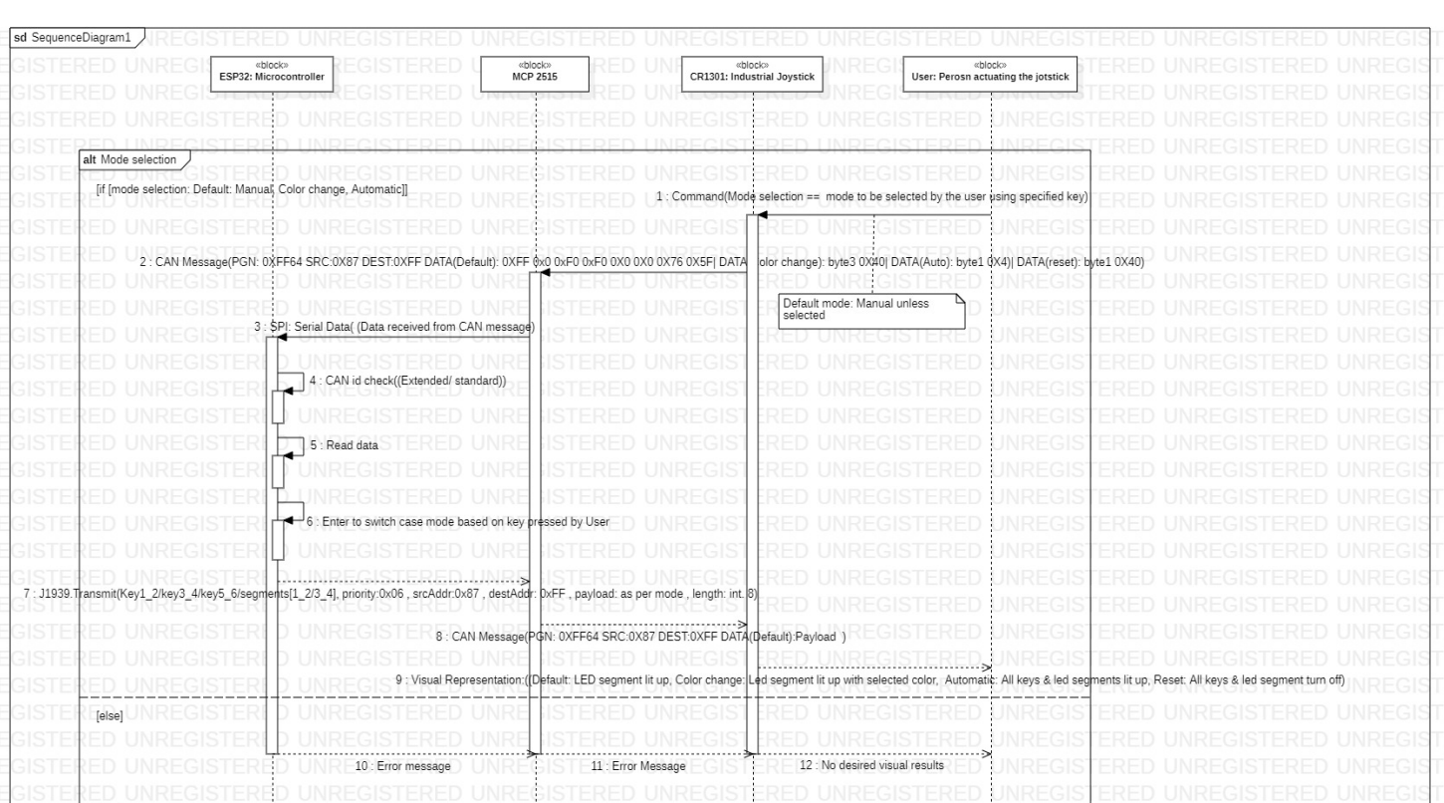
System specification: Sequence diagram

Slide 6
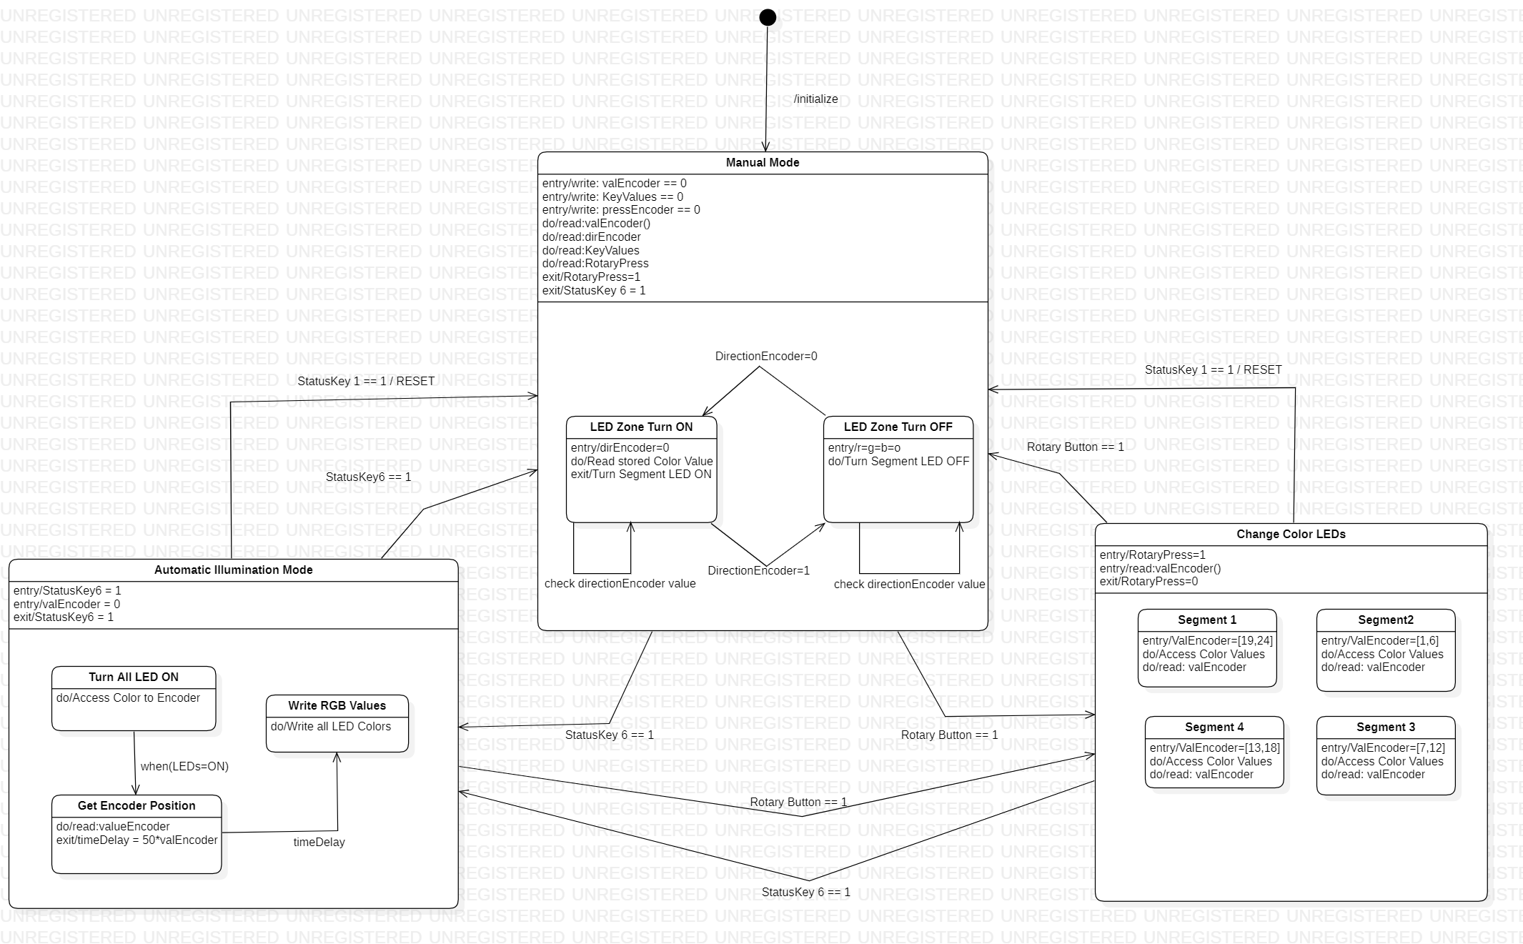
System specification: State Machine Diagram

Slide 7
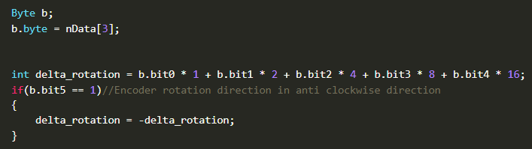
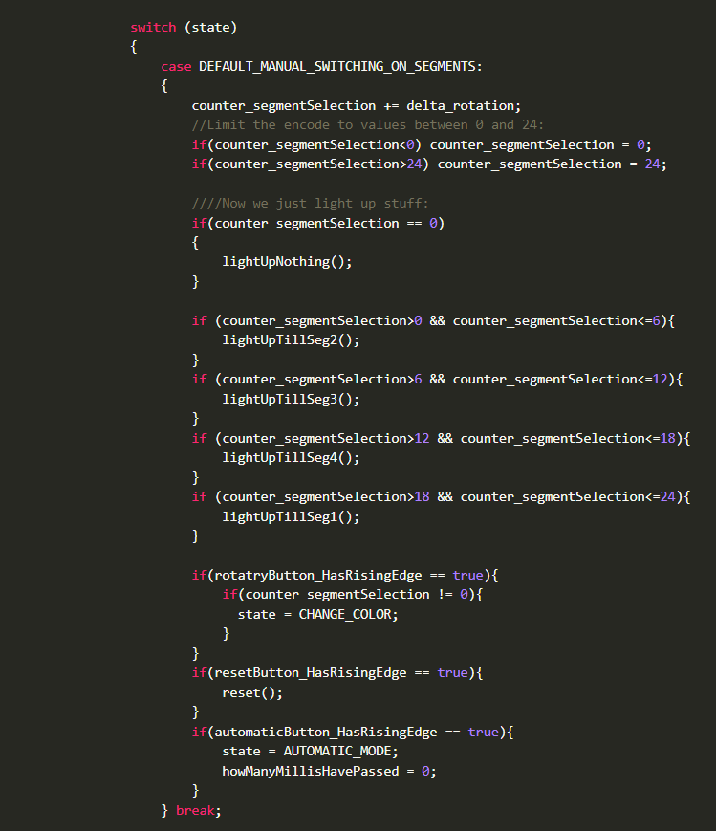
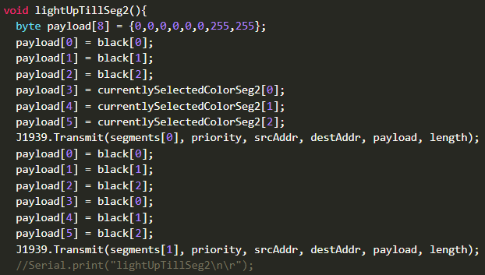
Execution and Testing: Manual Mode
Identifying the encoder position and direction
Switch case: Manual mode
Payload function: for segment led lit up

Slide 8
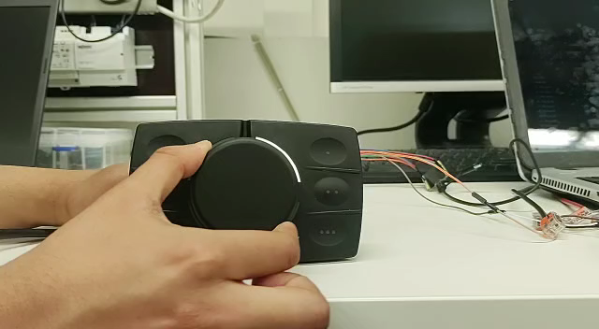
Execution and Testing: Manual Mode
Video Demonstration:

Slide 9
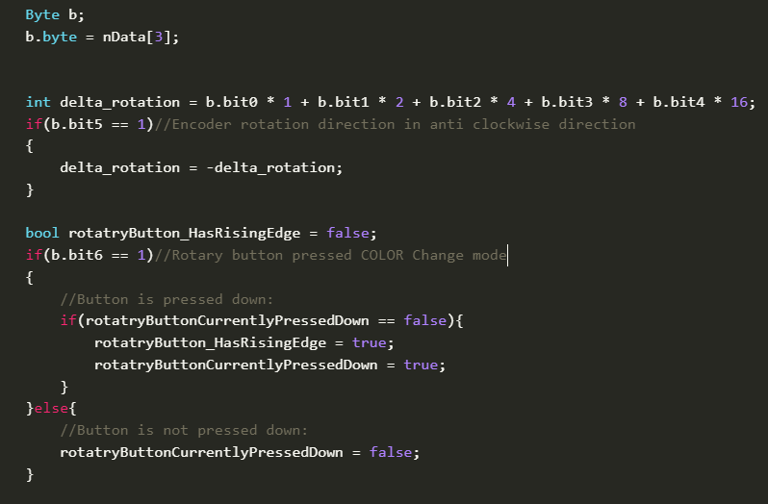
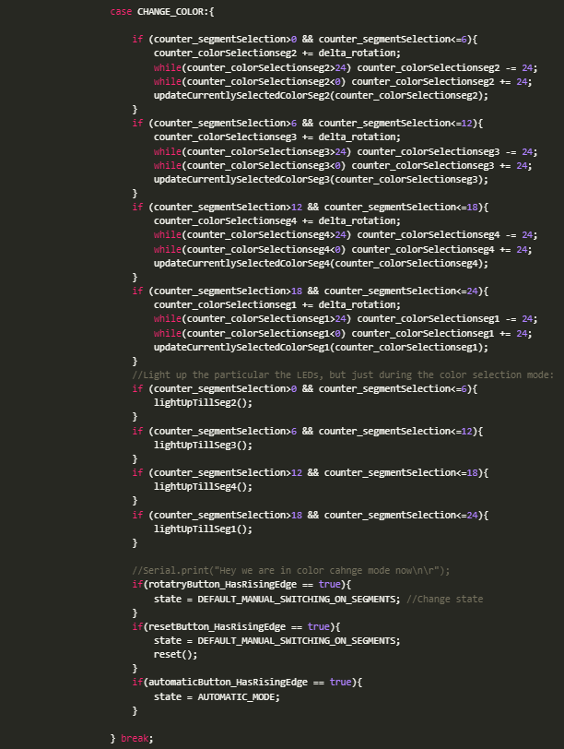
Execution and Testing: Color selection Mode
Identifying the encoder position, direction
and rotary button press
Switch case: color selection mode

Slide 10
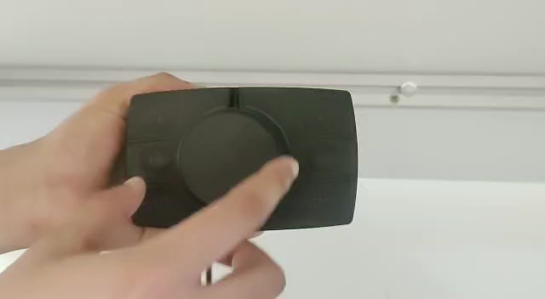
Execution and Testing: Color selection Mode
Video Demonstration:

Slide 11
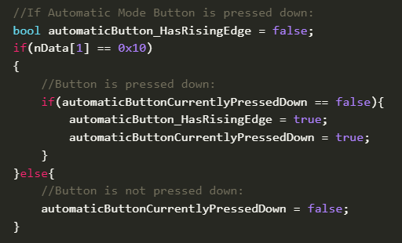
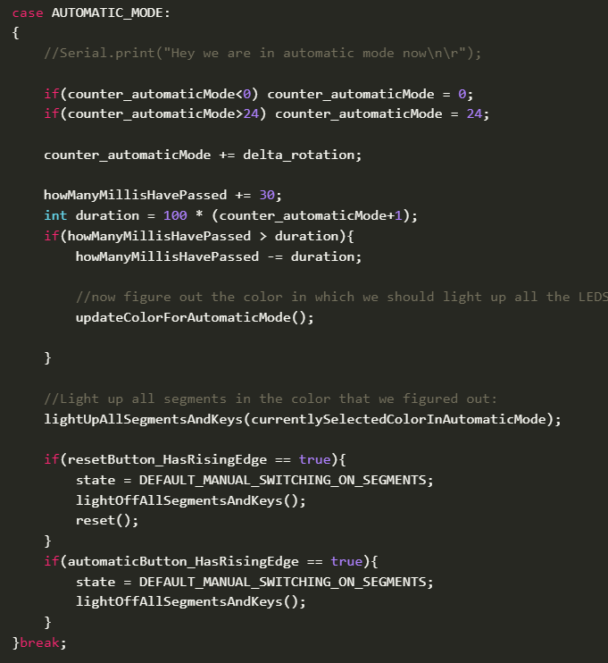
Execution and Testing: Automatic Mode
Identifying the automatic mode button press
Switch case: Automatic mode

Slide 12
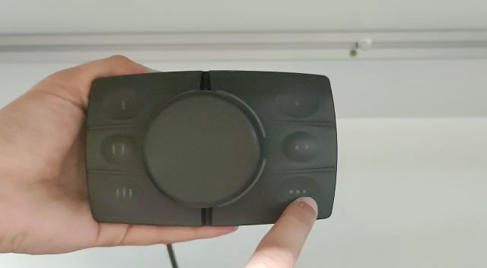
Execution and Testing: Automatic Mode
Video Demonstration:

Slide 13
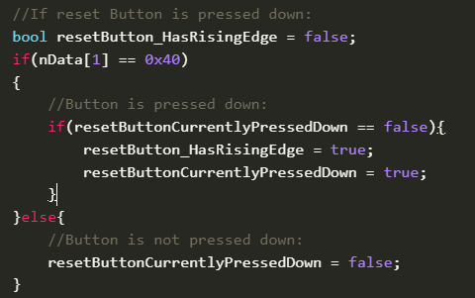
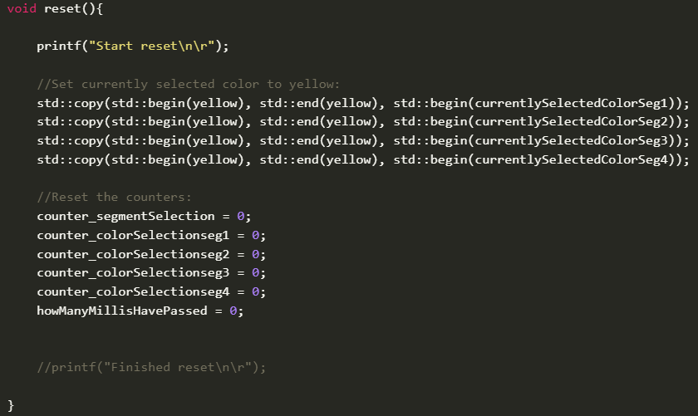
Execution and Testing: Reset Function
Identifying the reset button press
Reset function

Slide 14
Advantages
Product features:
Rising edge detection is used to switch between different states
Switch case structure is used for defining states. It made program simple, short and easy to understand
Bit access is used to find the instances of rotary button press and encoder rotation direction
Each states has its own counter, to retain its previous value and avoid any program error

Slide 15

Thank You !!

